Slide 1



Slide 2








AKRA HOTELS
2013
2013
2014
AKRA SORGUN
AKRA KEMER
AKRA ANTALYA
2014
2015
2019
AKRA V
AKRA FETHİYE
AKRA FETHİYE THE RESIDENCE

Slide 3
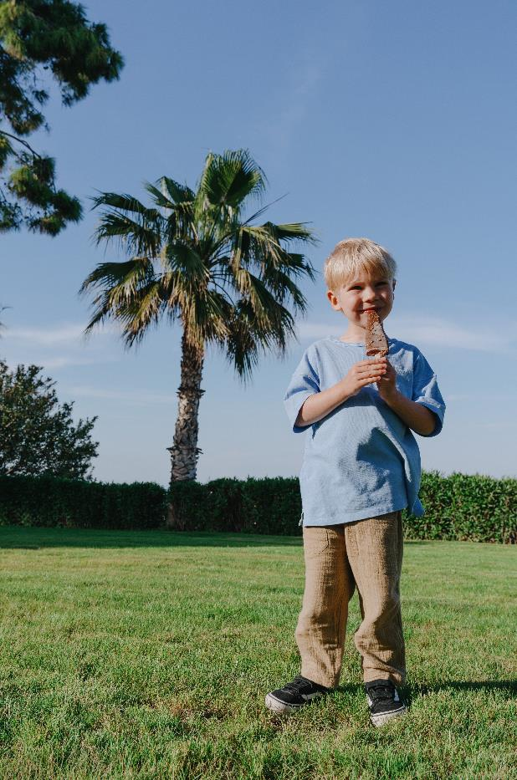


All Akra Hotels provide for little guests:
Baby Crib
Baby Pushchair
Baby Auido Monitor
Diaper Changing Pads
Baby Bath
Baby Potty
*Baby formula and diapers can be supplied for a fee from the hotel grocery.
Baby Shampoo
Baby Bath Puff
Baby Bib
Baby Body Lotion
Kettle
Baby Wipes
Feeding Chair

Slide 4


We protect nature.
We are committed to fulfilling our environmental responsibilities through sustainable resources, reducing and adapting to climate change, and protecting biodiversity and ecosystems.

Slide 5
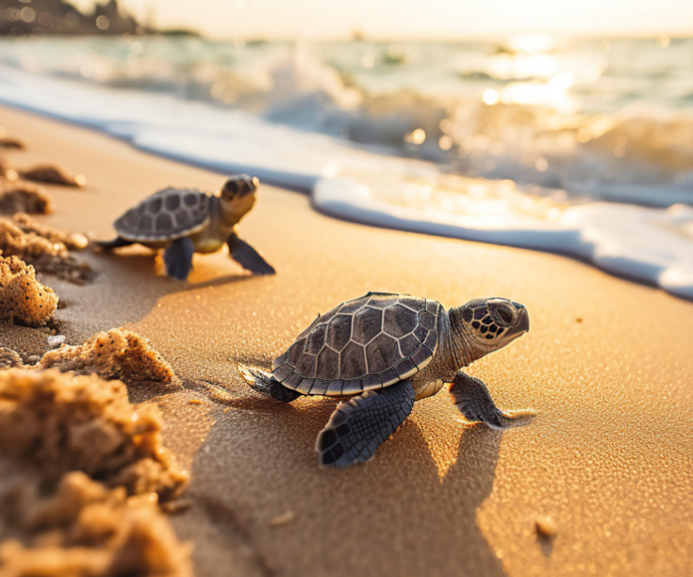
Protection of sea lilies and Caretta Caretta habitats
Supporting the local economy
Waste management through source separation, recovery of used cooking oils, water services in jugs, and using industrial products instead of plastic packaging
Reducing paper consumption
Chemical management
Energy management using solar panels, double glazing, and timely outdoor lighting
Backwashing processes to reduce water consumption
Birdhouses and the protection of biodiversity

Slide 6

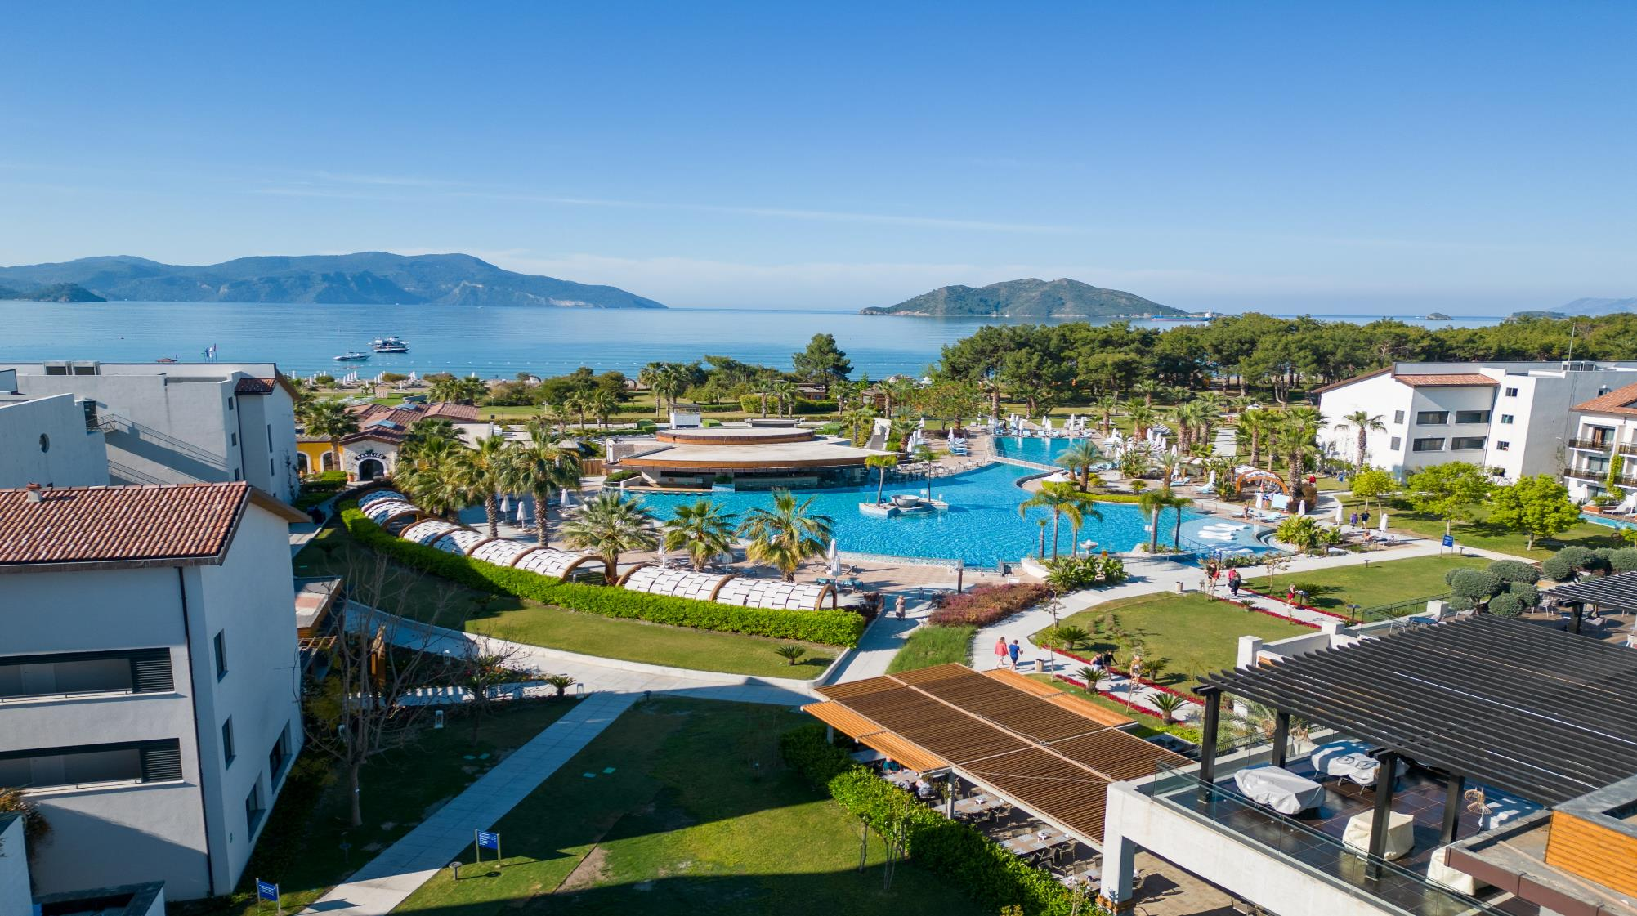


418 Rooms
65.000 m²
Ultra All Inculisive
Zones: ADULT / MIXED / FAMILY
45 km to Dalaman Airport
The 11th holiday resort of Fethiye according to the
guest rating of Tripadvisor.

Slide 7
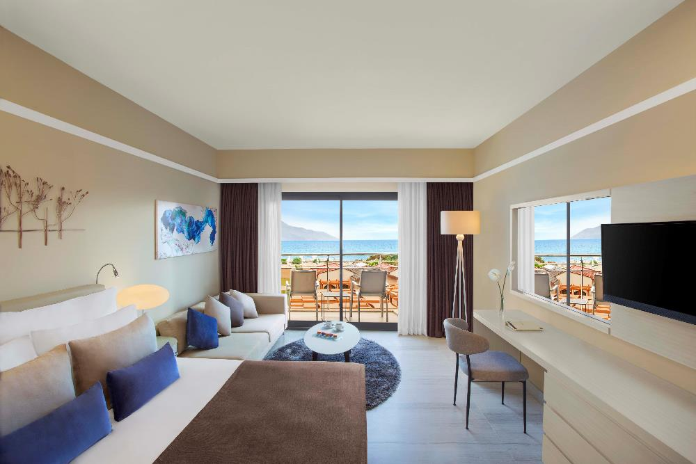
ROOMS
Adult Area
Standart Land View (40 m2)
Standart Side Sea View (40m2)
Standart Sea View (43 m2)
Standart Swim-Up (45 m2)
Mixed Area
Standart Land View (40 m2)
Standart DBL4 Room Land View (43 m2)
Standart Sea View (43 m2)
Family Area
Family Garden View (46 m2)
Family Side Sea View (46 m2)
Family Swim-Up (51 m2)
Superior Family Swim-Up (69 m2)

Slide 8
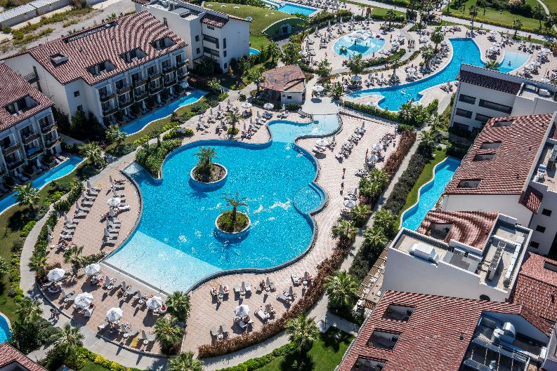
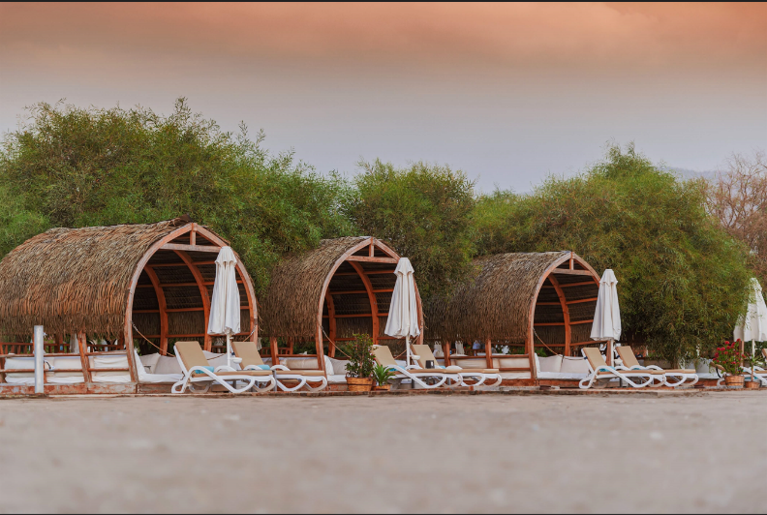
POOLS & BEACH
Main Pool
Adult Only Pool
Slide Pool
Indoor Pool
Cabanas
Hotel Own Beach

Slide 9
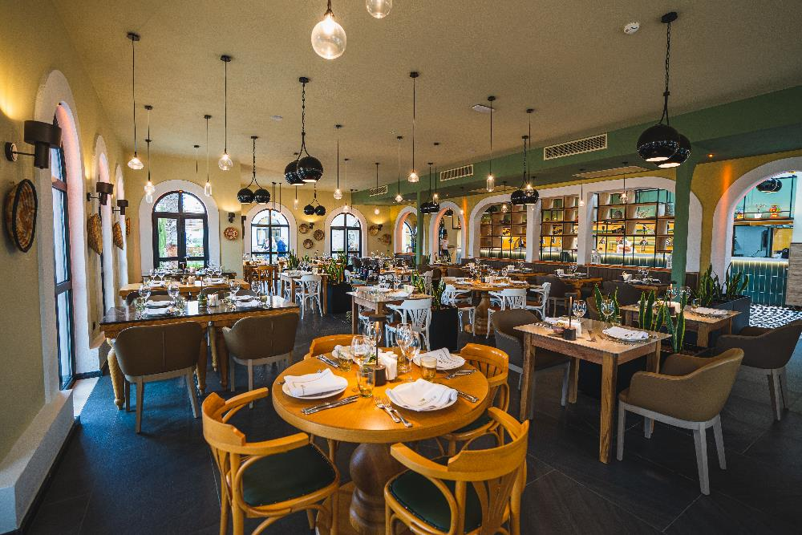
RESTAURANTS
The Restaurant (Main)
Amber (Turkish)
Sunset (Steak House)
Basilico (Italian)
Neoman (International)
Tao (Asian)
Gözleme
*24 Hours Bar & Food Service

Slide 10
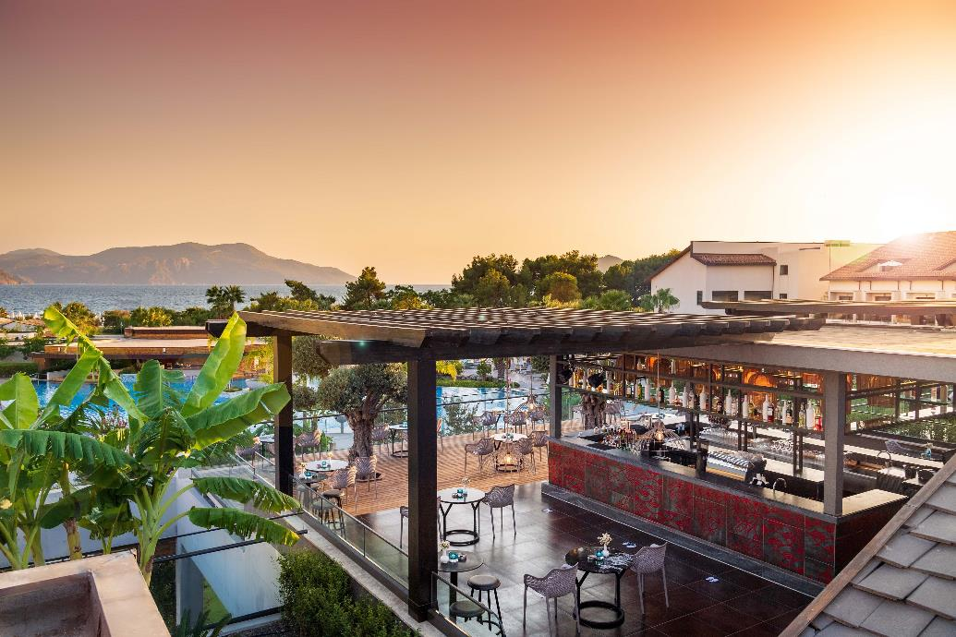
BARS
The Bar (24 Hours)
Sunset Beach Bar
Lime Pool Bar
Yasmine Pool Bar (+16 Adult)
Club House Bar
Neoman Lounge & Terrace Bar (+16 Adult)

Slide 11
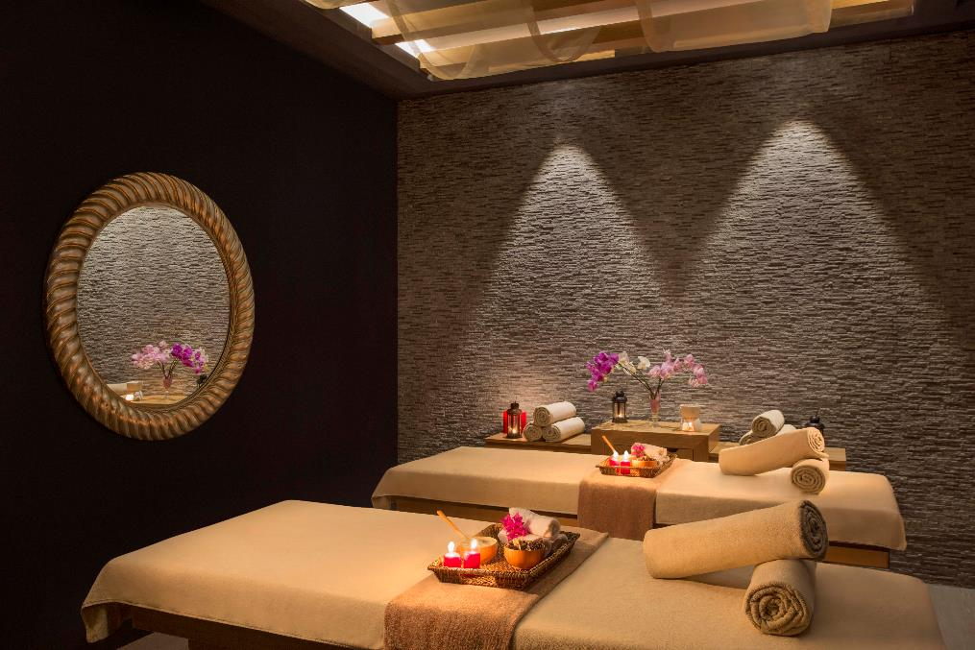
SPA
Fitness
Sauna
Turkish Bath
Resting Area
Massage Rooms
Outdoor Activities Area

Slide 12
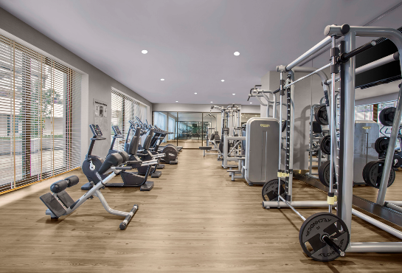
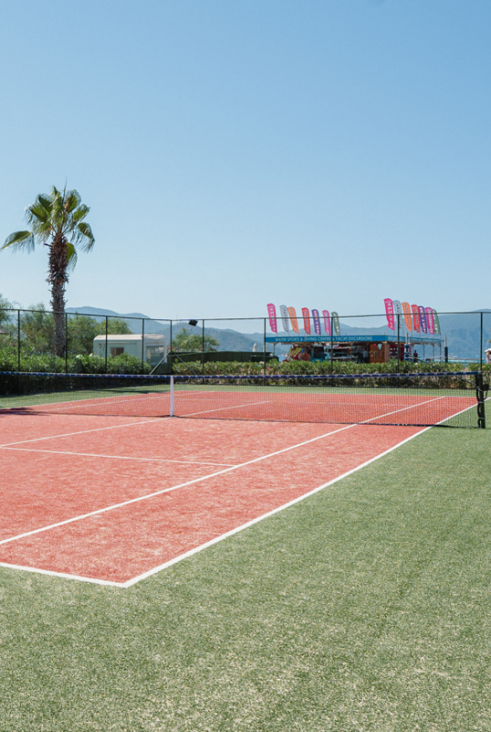
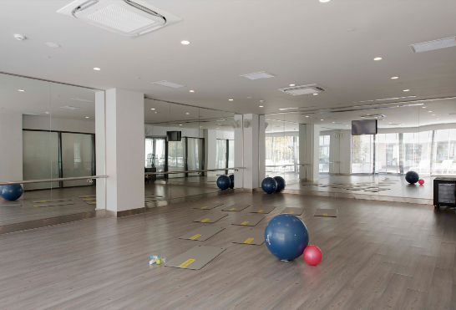
SPORTS & ACTIVITIES
Football
Tennis
Volleyball
Table Tennis
Step/Aerobic
Fitness Centre (Gymnasium)
Jogging Area
Archery
Multipurpose Court
Dance Studio

Slide 13
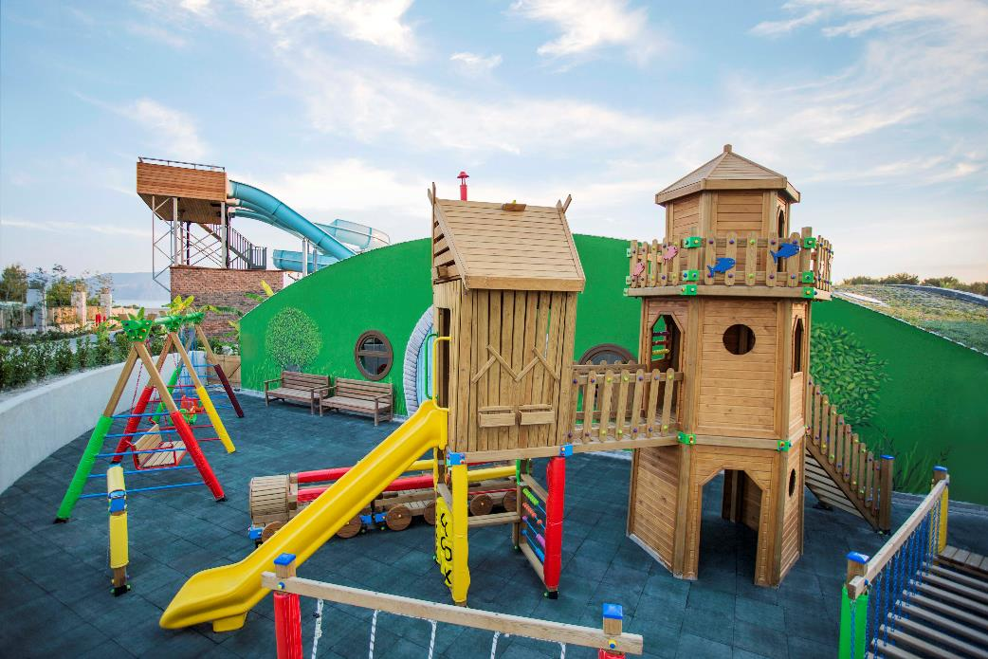
KIDS AREA
Kids Pool
Mini Club
Playgrounds on the Beach
Outdoor Playgrounds

Slide 14

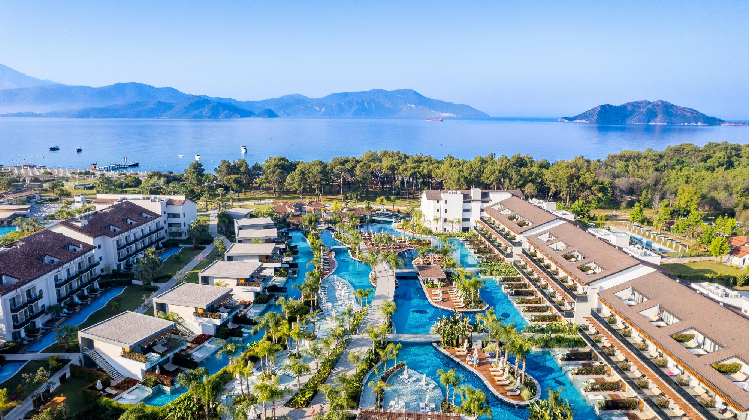


158 Rooms
24.000 m²
A'la Carte Ultra All Inclusive
Adult Only
45 km to Dalaman Airport
The 3rd holiday resort of Fethiye according to the
guest rating of Tripadvisor.
*Hotel guests can use the services of Akra Fethiye.

Slide 15
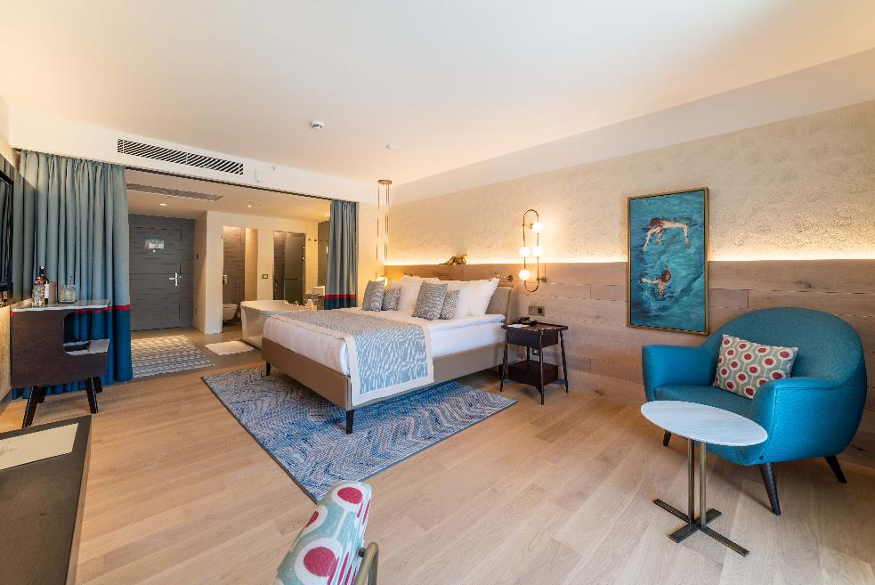
ROOMS
Superior Double Room (54 m2)
Superior Junior Suite (62 m2)
Penthouse With Jacuzzi (68 m2)
Superior Double Swim-Up Room (68 m2)

Slide 16
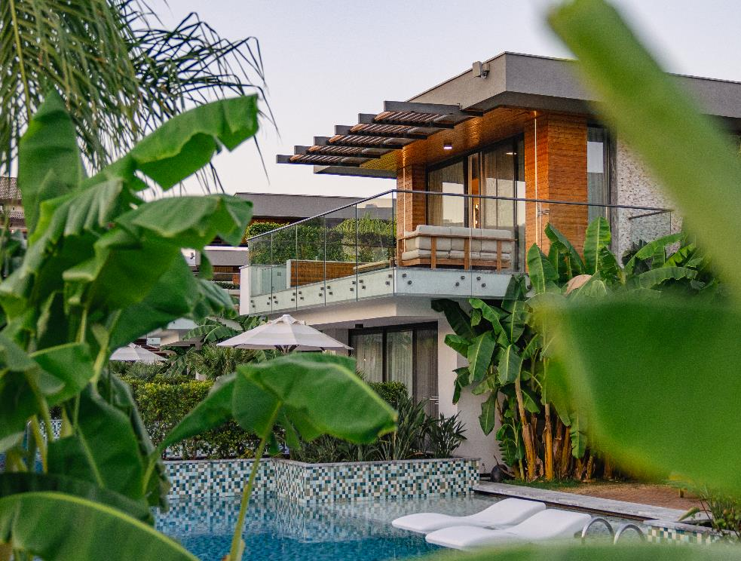
ROOMS
Lake House Suite with Jacuzzi (95m2)
Lake House Suite Swim-Up (78 m2)

Slide 17
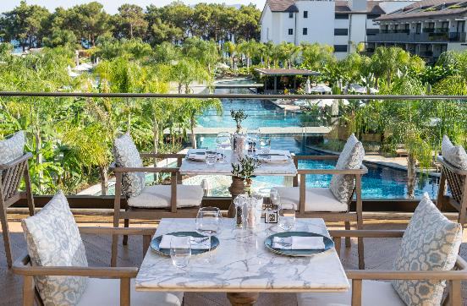
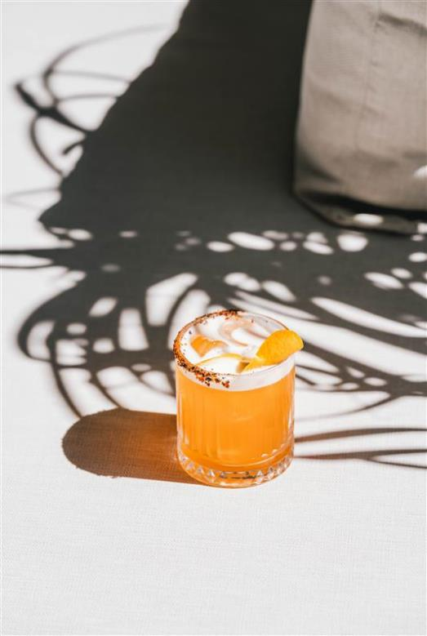
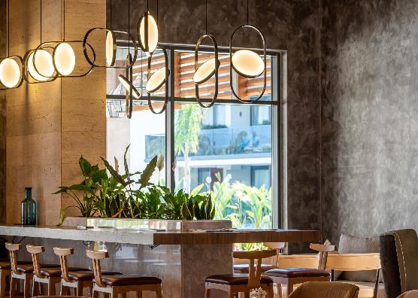
RESTAURANTS & BARS
Food Repertory (Main Restaurant)
Cuphea A'la Carte & Snack
Balkon Lounge
Executive Lobby & Lounge
Watergate Bar
Beach Bar
*24 Hours Bar & Food Service

Slide 18
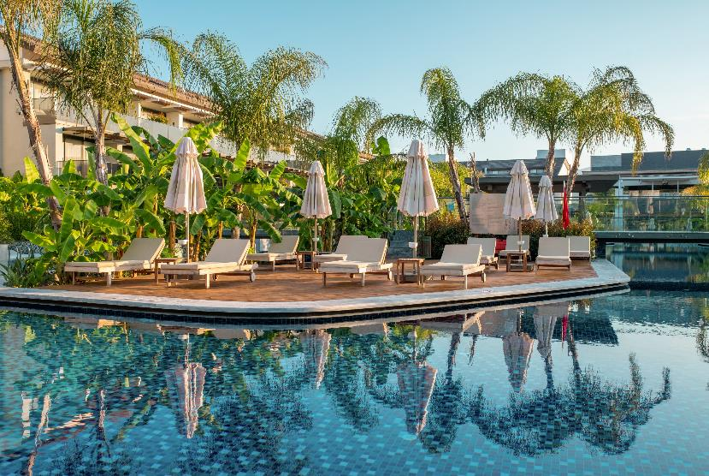
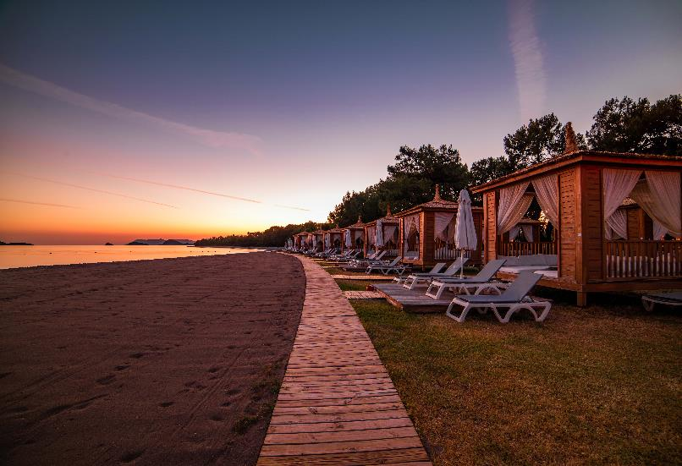
POOLS & BEACH
Cabanas
Hotel Own Beach
Main Pool (5.092 m2)

Slide 19
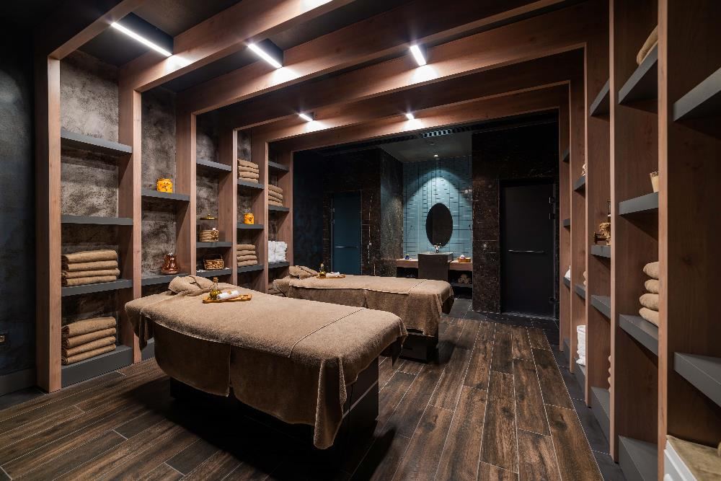
SPA
Individual Training
Private Hammam
Fitness

Slide 20
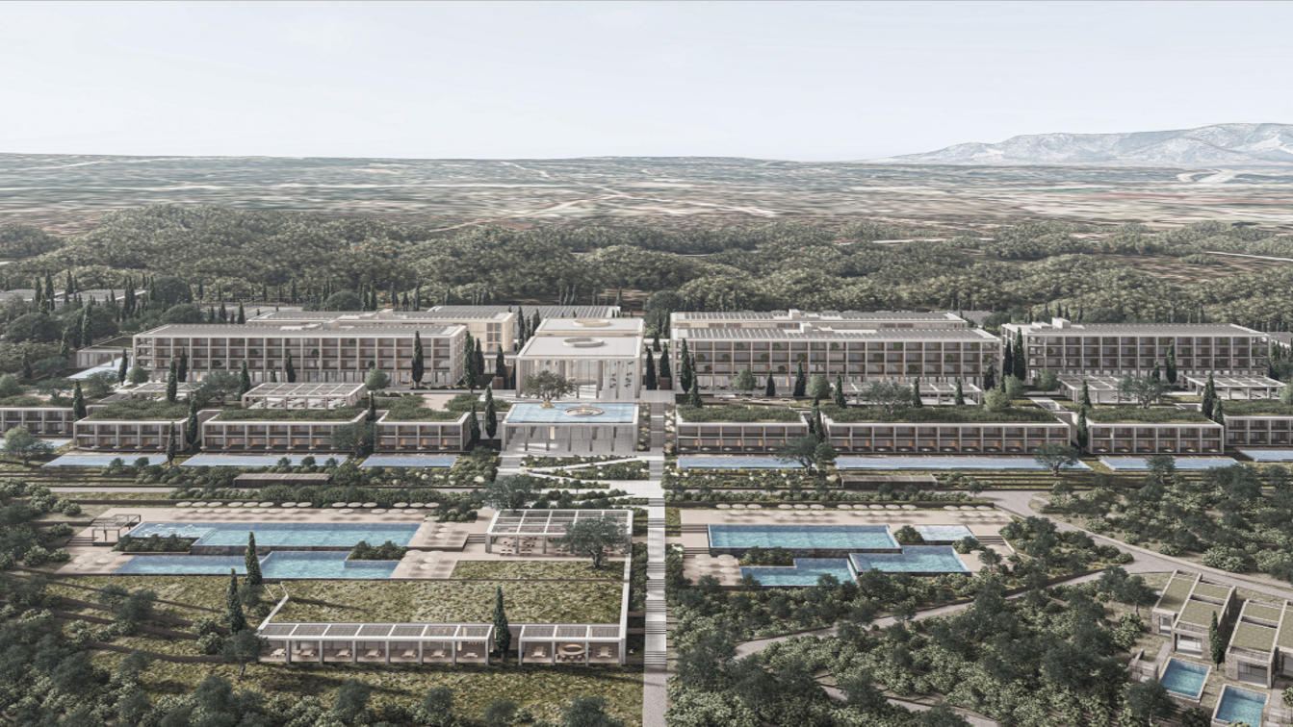


COMING SOON

Slide 21
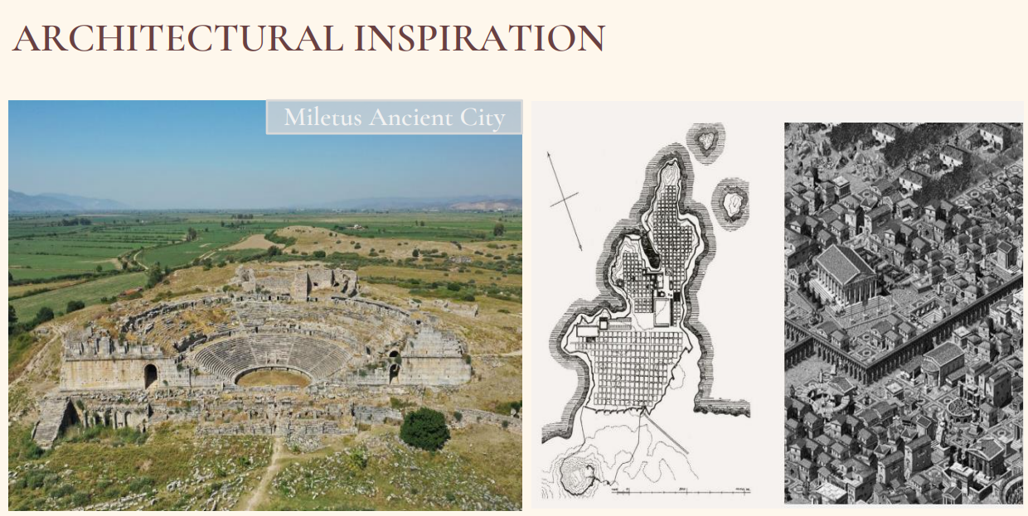

Slide 22
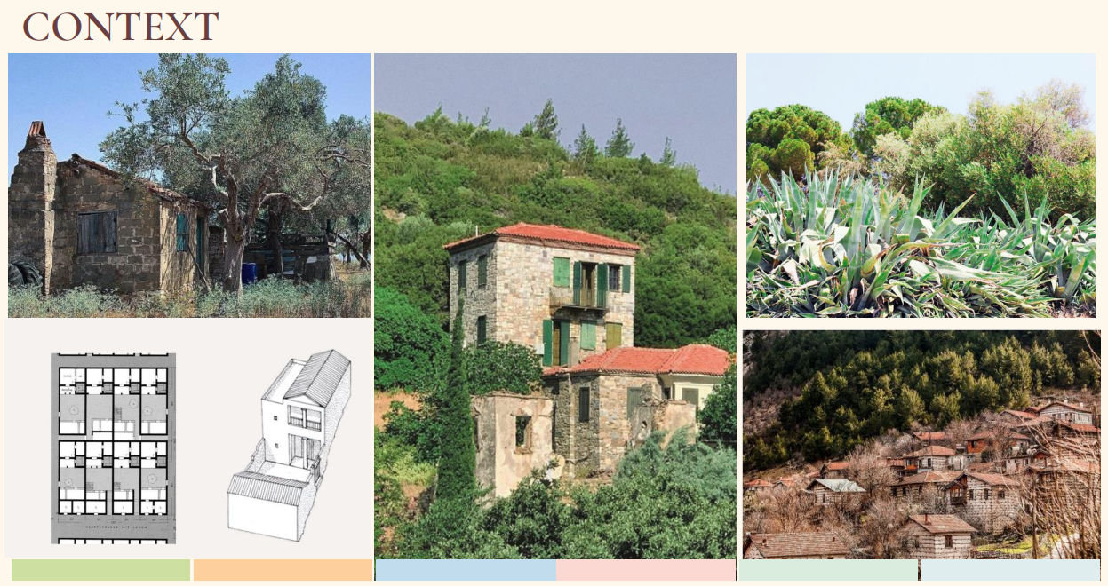

Slide 23
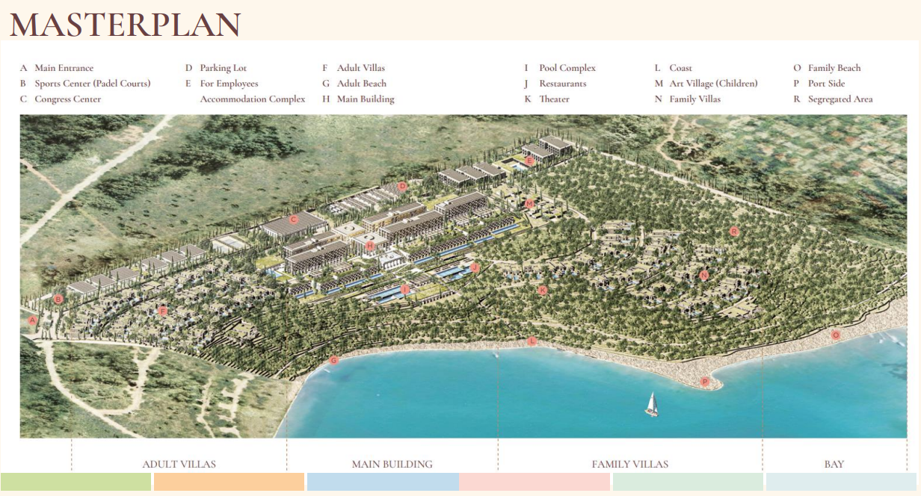

Slide 24
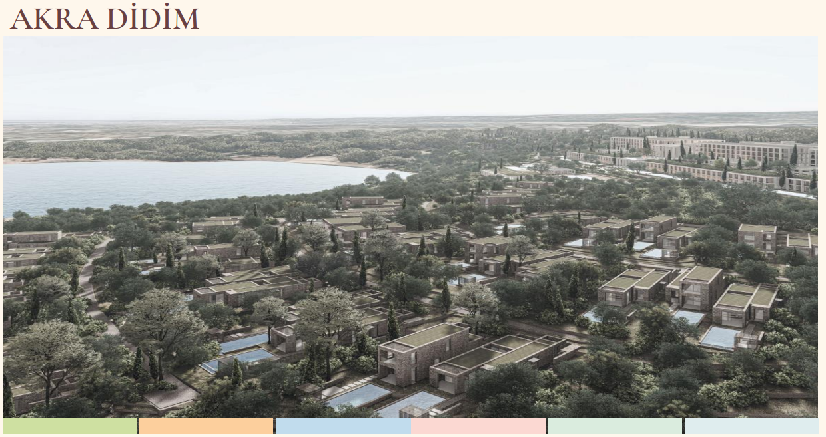

Slide 25
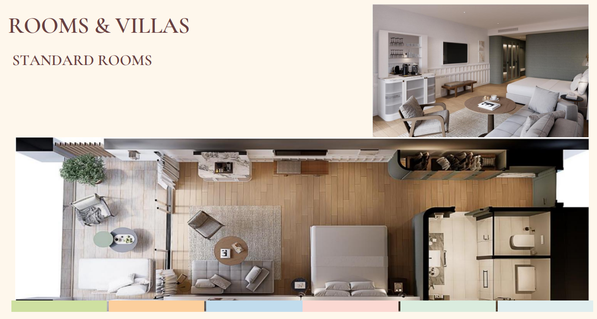

Slide 26
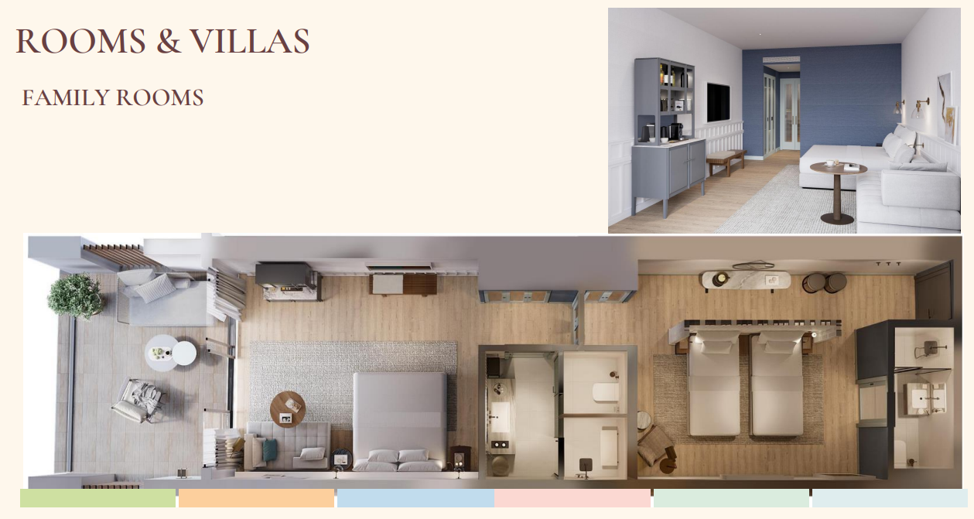

Slide 27
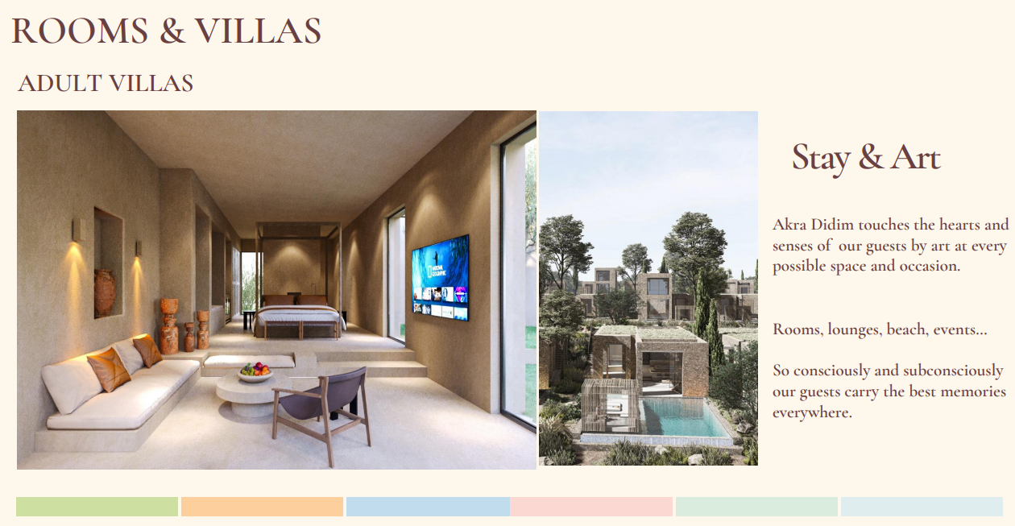

Slide 28

THANK YOU

